Slide 1
Graphs

Slide 2
Graph
Collection of 2 sets V &E
V=Set of Nodes=(v1,v1,v2……vn)
E=Set of Edges=(e1,e2,e3………en)
Edge=an arc that connects 2 nodes

Slide 3
Graph
2 Types
Undirected
Directed

Slide 4
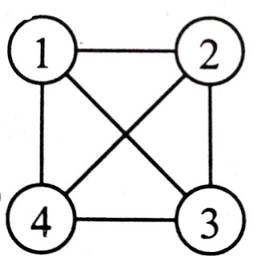
Undirected Graph
A graph, which has unordered pair of vertices, is called undirected graph.
Suppose there is an edge between v₀ & v₁ then it can be represented as (v₀,v₁) or (v₁,v₀) also
V(G) = {1,2,3,4}
E(G) = { (1,2), (1,3), (1,4), (2,3), (2,4), (3,4) }

Slide 5
Directed Graph
A graph which has ordered pair of vertices <v1,v2> where edge starts from v1 and ends at v2
Each edge has direction, means <v1,v2> and <v2,v1> will represent different edges.
Directed means that a direction will be associated with that edge.
Also known as digraph

Slide 6
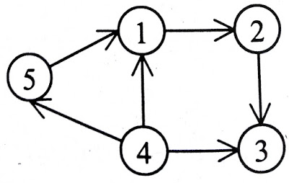
Directed Graph
V(G) = {1,2,3,4,5}
E(G) = { <1,2>, <2,3>, <4,3>, <4,1>, <4,5>, <5,1> }

Slide 7
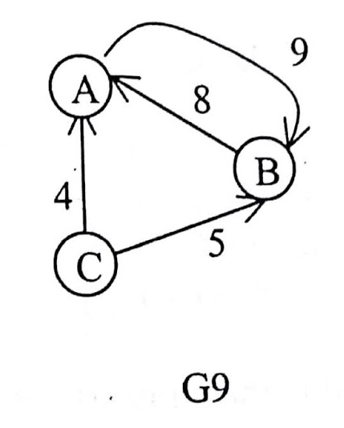
Graph Terminology
Weighted Graph
A graph is said to be weighted if it's edges have been assigned some non negative value as weight.
A weighted graph is also known as network.
Graph G9 is a weighted graph.

Slide 8
Graph Terminology
Adjacent nodes
A node u is adjacent to another node or is a neighbor of another node v if there is an edge from node u to node v.
In undirected graph if (v0,v1) is an edge then v0 is adjacent to v1 and v1 is adjacent to v0.
In a digraph if <v0,v1> is an edge then v0 is adjacent to v1 and v1 is adjacent from v0

Slide 9
Graph Terminology
Incidence :-
In an undirected graph the edge (v0,v1) is incident on nodes v0 and v1.
In a digraph the edge <v0,v1> is incident from node v0 and is incident to node v1.
Path :-
A path from node u0 to node un is a sequence or nodes u₀,u₁,u₂,u₃.......u_{n-1},u_{n} such that u₀ is adjacent to u₁, u₁ is adjacent to u₂,...........,u_{n-1} is adjacent to u_{n} .
Length of path :-
Length of a path is the total number of edges included in the path.

Slide 10
Graph Terminology
Closed path :-
A path is said to be closed if first and last nodes of the path are same.
Simple path :-
Simple path is a path in which all the nodes are distinct with an exception that the first and last nodes of the path can be same.

Slide 11
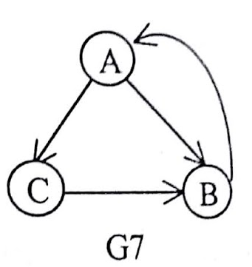
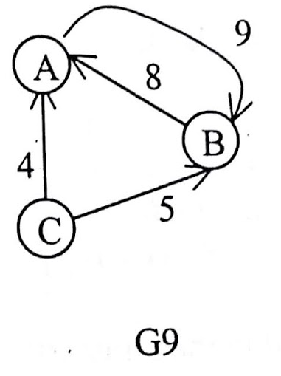
Graph Terminology
Cycle :-
Cycle is a simple path in which first and last nodes are the same or we can say that a closed simple path is a cycle.
In graph G7, path ACBA is a cycle
In graph G9 path ABA is a cycle.

Slide 12
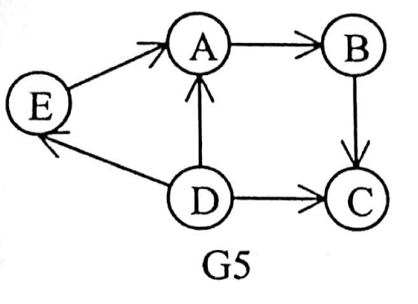
Graph Terminology
Cyclic graph :-
A graph that has cycles is called a cyclic graph.
Acyclic graph :-
A graph that has no cycles is called an acyclic graph.
Dag :-
A directed acyclic graph is named as dag after its acronym.
Graph G5 is an example of a dag.

Slide 13
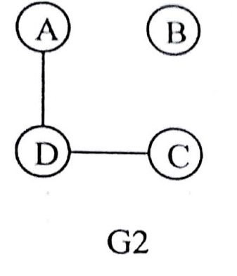
Graph Terminology
Degree :-
In an undirected graph,
the number of edges connected to a node is called the degree of that node,
or
we can say that degree of a node is the number of edges incident on it.
In graph G2 degree of node A is 1, degree of node B is zero.

Slide 14
Graph Terminology
In a digraph, there are two degrees for every node known as indegree and outdegree.
Indegree
Outdegree

Slide 15
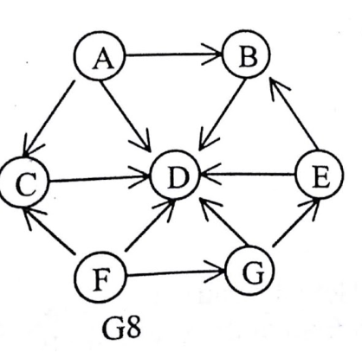
Graph Terminology
Indegree :-
The indegree of a node is the number of edges coming to that node or in other words edges incident to it.
In graph G8, the indegree of nodes A, B, D and G are 0, 2, 6 and 1 respectively.
Outdegree :-
The outdegree of node is the number of edges going outside from that node, or in other words the edges incident from it.
In graph G8, outdegrees of nodes A, B, D, F, and G are 3, 1, 0, 3, and 2 respectively.

Slide 16
Representation of Graph
There are two ways for representing the graph in computer memory.
sequential representation and
linked list representation.

Slide 17
Representation of Graph
Adjacency Matrix :-
Keeps the information of adjacent nodes.
that whether this node is adjacent to any other node or not.

Slide 18
Representation of Graph
Adjacency Matrix :-
Represent a matrix in two dimensional array
array[n][n]
Suppose there are 4 nodes in graph then row1 represents the node1, row2 represents the node2 and so on.
Similarly column1 represents node1, column2 represents nde2 and so on.
The entry of this matrix will be as-
Arr[i][j] = 1 If there is an edge from node i to node j
= 0 If there is no edge from node i to node j
Hence, all the entries of this matrix will be either 1 or 0.

Slide 19
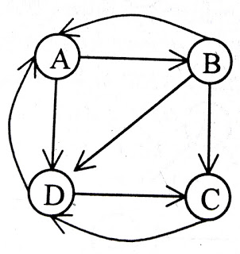
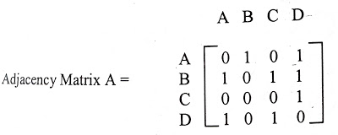
Representation of Graph
Adjacency Matrix :-
arr[0][1] = 1, which represents there is an edge in the graph from node A to node B.

Slide 20
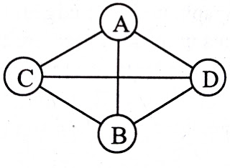
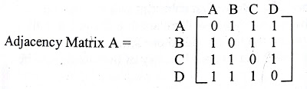
Representation of Graph
Adjacency Matrix :-
arr[0][1] = 1, which represents there is an edge in the graph from node A to node B.

Slide 21
Representation of Graph
Adjacency Matrix :-
In an undirected graph
rowsum and columnsum for a node is same and represents the degree of that node and

Slide 22
Representation of Graph
Adjacency Matrix :-
In directed graph,
rowsum represents the outdegree
columnsum represents the indegree of that node.

Slide 23

Representation of Graph
Adjacency Matrix :-
Weighted Graph

Slide 24
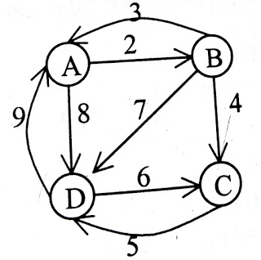

Representation of Graph
Adjacency Matrix :-
arr[0][1] = weight, which represents there is an weighted edge in the graph from node A to node B.

Slide 25
Adjacency List :-
If the adjacency matrix of the graph is sparse then
it is more efficient to represent the graph through adjacency list.
We will maintain two lists.
First list will keep track of all the nodes in the graph
Second list will maintain a list of adjacent nodes for each node.

Slide 26
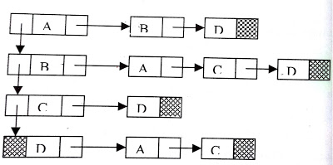
Adjacency List :-
Suppose there are n nodes then we will create one list which will keep information of all nodes in the graph
After that we will create n lists, where each list will keep information of all adjacent nodes of that particular node.
Each list has a header node, which will be the corresponding node in the first list.

Slide 27
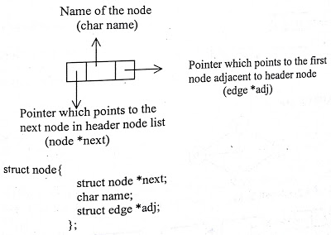
Structure of header node :

Slide 28
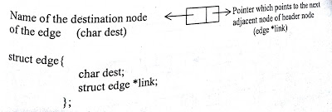
Structure of edge :

Slide 29
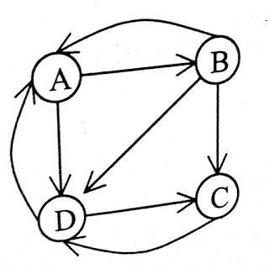
Adjacency list:

Slide 30
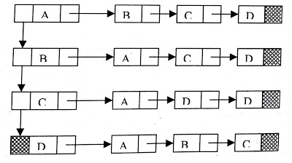
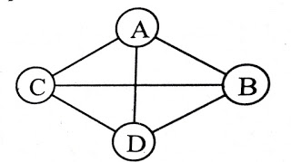
Adjacency list:

Slide 31
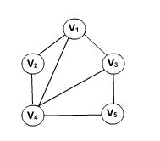
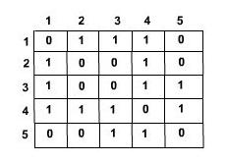
Adjacency Matrix Representation:

Slide 32
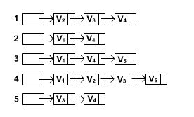
Adjacency Matrix Representation:

Slide 33
Operations on graph
The two main operations on graph will be-
Insertion
Deletion
Here insertion and deletion will be also on two things-
On node
On edge

Slide 34
Insertion in Adjacency Matrix :
Node insertion :-
Insertion of node requires only addition of one row and one column with zero entries in that row and column.

Slide 35
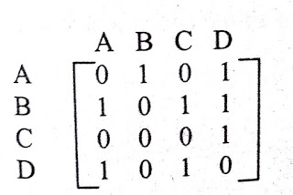
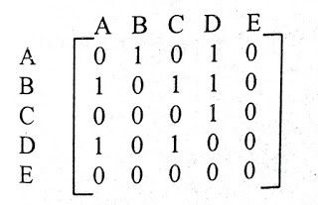
Insertion in Adjacency Matrix :
Node insertion :-
Let us take an adjacency matrix-
Suppose we want to add one node E in the graph then we have a need to add one row and one column with all zero entries for node E.

Slide 36
Edge insertion :-
Insertion of edge requires changing the value 0 into 1 for those particular nodes.

Slide 37
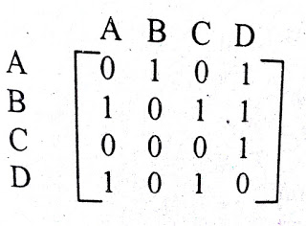
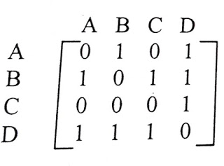
Edge insertion :-
Let us take an adjacency matrix-
There is no edge between D to B.
Suppose we want to insert an edge between D to B, then we have a need to change the 0 entry into 1 at the position 4th row 2nd column.
Now the adjacency matrix will be-

Slide 38
Deletion in Adjacency Matrix :
Node deletion :-
Deletion of node requires deletion of that particular row and column in adjacency matrix for node to be deleted
As node deletion requires deletion of all the edges which are connected to that particular node.

Slide 39
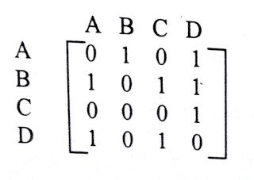
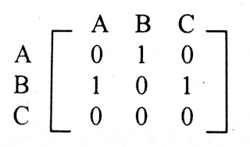
Deletion in Adjacency Matrix :
Node deletion :-
Let us take an adjacency matrix-
Suppose we want to delete the node D, then 4th row and 4th column of adjacency matrix will be deleted. Now the adjacency matrix will be-

Slide 40
Edge deletion :-
Deletion of an edge requires changing the value 1 to 0 for those particular nodes.

Slide 41
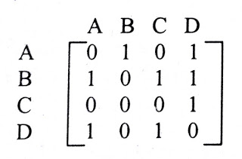
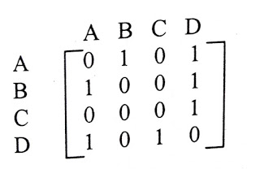
Edge deletion :-
Let us take an adjacency matrix-
To delete the edge which is in between B and C,
Change the entry 1 to 0 at the position 2nd row, 3rd column.
Adjacency matrix will be-

Slide 42
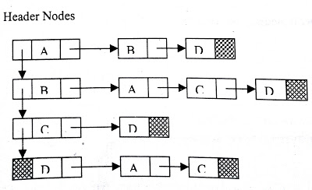
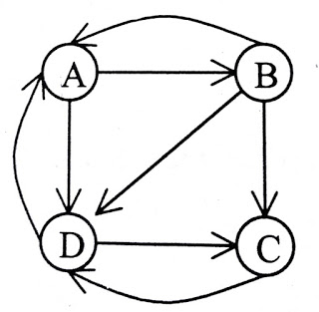
Insertion in Adjacency list
Node insertion :-
Insertion of node in adjacency list requires only insertion of that node in header nodes of adjacency list.
Let us take a graph G-
The adjacency list for this graph will be as-

Slide 43
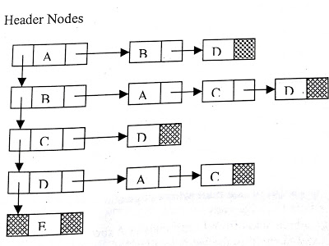
Insertion in Adjacency list
Suppose we want to insert one node E
Addition of node E in header node only.
Now the adjacency list will be-

Slide 44
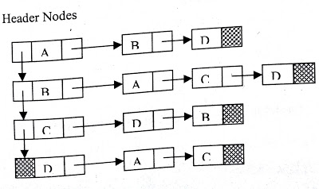
Edge insertion in Adjacency list
Insertion of an edge
Requires add operation in the list of the starting node of edge.
Remember here graph is directed graph.
In undirected graph, it will be added in the list of both nodes.
Add the edge which starts from node C and ends at node B, then add operation is needed in the list if C node.

Slide 45
Deletion in Adjacency list :
Node deletion :-
Deletion of node requires deletion of that particular node from header node and from the entire list wherever it's coming.
Deletion of node from header will automatically free the list attached to that node.

Slide 46
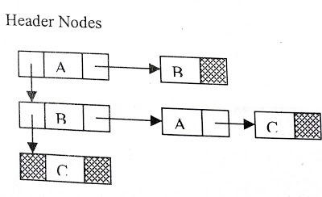
Deletion in Adjacency list :
Node deletion :-
Delete the node D from graph
Delete node D from header node and from the list of A, B and C nodes.

Slide 47
Deletion in Adjacency list :
Edge deletion :-
Deletion in the list of that node where edge starts, and that element of the list will be deleted where the edge ends.

Slide 48
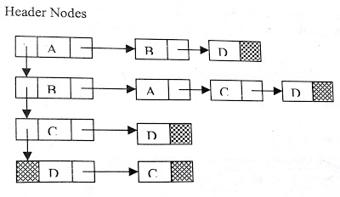
Deletion in Adjacency list :
Edge deletion :-
Delete the edge which starts from D and ends at A
Delete in the list of node D and element in the list deleted will be A.

Slide 49
Traversal of Graph
The various graph traversals are
Depth first search (DFS)
Breadth first search (BFS)

Slide 50
Depth First Search
This method is called depth first search since searching is done forward (deeper) from current node.
The distance from start vertex is called depth

Slide 51
Depth First Search
Choose a starting node, mark it visited ,traverse it Push it into the stack
Rule 1 : If possible, visit an adjacent unvisited vertex, mark it visited, traverse it and push it on the stack.
Rule 2 : If Rule 1 fails, then pop a vertex off the stack follow Rule 1 from it.
i.e. For the Vertex on the top of the stack, If there is no unvisited adjacent node only then we pop it.
Rule 3 : Repeat Rule 1 and Rule 2 until the all the vertices are visited.

Slide 52
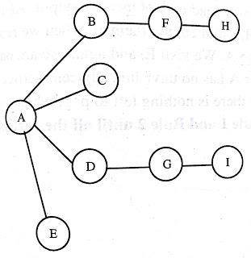
Example of Depth First Search : Let us consider the following graph-
The depth-first search (DFS) uses a stack to remember where it should go when it reaches a dead end.

Slide 53
Depth First Search
To carry out the depth-first search, we pick a starting point, vertex A.
We can do three things:
Visit the vertex
Push it onto stack so we can remember it, and
Mark it, so it is not visited again.

Slide 54
Depth First Search

Slide 57
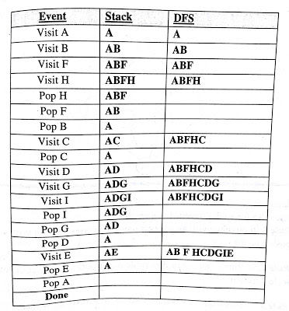
Depth First Search
Assuming the vertex are visited in alphabetical manner
Visit the next vertex connected to A.
It is B
The vertex B is pushed into the stack and marked as visited, traverse it We are now at B.
The adjacent unvisited vertex of B i.e. F is visited, traversed, pushed into stack
We call this process Rule 1

Slide 58
Depth First Search
Rule 1
If possible, visit an adjacent unvisited vertex, mark it visited, and push it on the stack.
Applying Rule 1 the vertex H is visited.
Now from here there is no further unvisited adjacent vertex that we can visit.
This condition is called dead end. Now we apply Rule 2.

Slide 59
Depth First Search
Rule 2
If Rule 1 fails, then pop a vertex off the stack follow Rule 1 from it.

Slide 60
Depth First Search
Following Rule 2, we pop H off the stack, which brings us back to F.
F also has no unvisited adjacent vertices, so we pop it also.
It applies to B also.
Now only A is left on the stack. A, however, does have unvisited adjacent vertices, so we now visit C and push C.
But C also becomes a dead end.
Hence we pop it.
Again we are left with A.

Slide 61
Depth First Search
We visit D, G, I, and then pop them all when we reach a dead end at I
Now we are back to A
We visit E, and again we are back to A This time, however A has no unvisited adjacent vertices.
So we pop it off the stack.
But now there is nothing left to pop, which brings us to Rule 3.
So Stop

Slide 62
Depth First Search
Rule 3 : Repeat Rule 1 and Rule 2 until the all the vertices are visited.

Slide 63
Depth First Search
The table below shows the stack contents at each push and pop operations:
Required DFS is ABFHCDGIE

Slide 64
DFS-Procedure using Stack-
Use array implementation of stack to keep the unvisited neighbors of the node
Initially stack is empty and top =-1
Take a Boolean Array, visited[n]
In which value ,
visited[i]=false, If node has not been visited
visited[i]=true, If node has been visited
Initially visited[i]=false where i=1 to n, n is total no of nodes

Slide 65
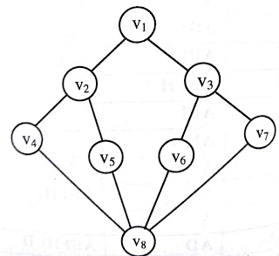
Perform DFS

Slide 66
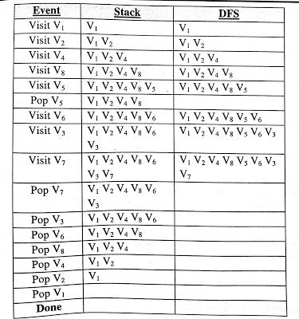
Perform DFS
The required DFS is V₁ V₂ V₄ V₈ V₅ V₆ V₃ V₇

Slide 67
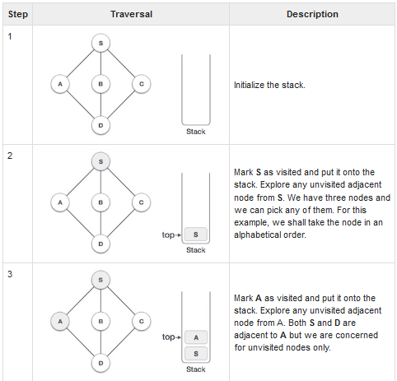
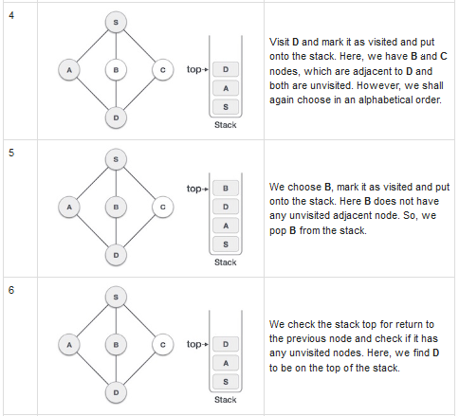
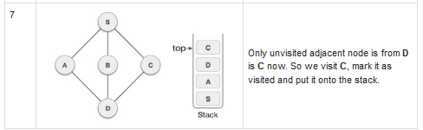
Depth-first search using Backtracking
Courtesy: https://www.tutorialspoint.com/data_structures_algorithms/depth_first_traversal.htm

Slide 68
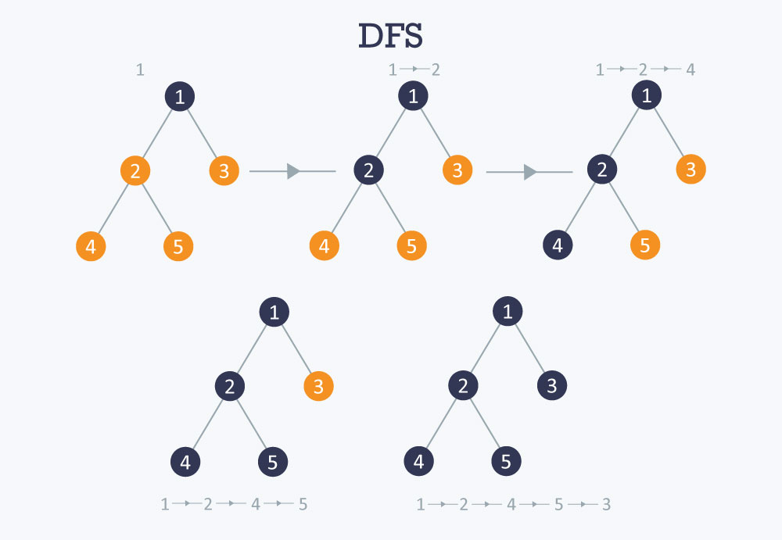
DFS
DFS of a graph is analogous to the pre-order traversal of an ordered tree.

Slide 69
Recursive Defn of DFS
Algorithm DFS ( G )
for i = 1 to n do // Initialize all vertices are unvisited
status[i] = unvisited
parent[i] = NULL
for i = 1 to n do
if (status[i] == unvisited) // If there exits an unvisited vertex, start traversal
DF-Travel(i)
Algorithm DF-Travel ( v )
status[v] = visited
for each vertex u adjacent to v do
if status[u] == unvisited then
parent[u] = v
DF-Travel ( u )

Slide 70
Breadth First Search
BFS of a graph is analogous to level-by-level traversal of an ordered tree.
This method is called breadth first search, since it works outward from a center point, much like the ripples created when throwing a stone into a pond.
It moves outward in all directions, one level at a time.

Slide 71
Breadth First Search
Choose the start node, mark it visited, traverse it, enqueue it
Rule 1 : Visit all the next unvisited vertices (if any) that is adjacent to the current vertex(At Front end), and insert them into a queue one at a time on every visit.
Rule 2 : If there is no unvisited vertex, remove a vertex from the Queue and make it the current vertex and then follow Rule 1.
Rule 3 : Repeat Rule 1 and Rule 2 until the all the vertices visited.

Slide 72
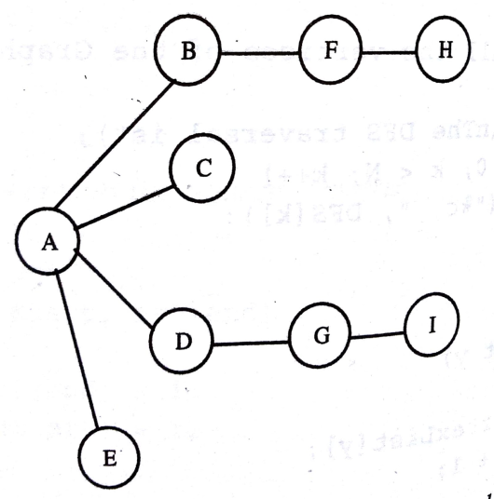
Breadth First Search
Let us consider the following graph-
In BFS, all the vertices adjacent to start vertex are visited, In first pass
This kind of search is implemented using a Queue

Slide 73
Breadth First Search

Slide 74
Breadth First Search

Slide 75
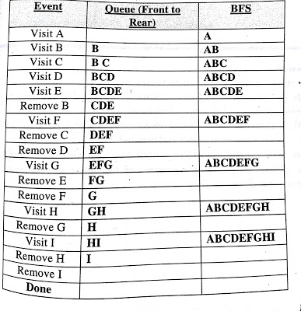
Breadth First Search
Let us consider the following graph-
Pick a starting point,
Lets start with vertex A.
We mark it as visited, traverse it
Then rules are applied

Slide 76

Breadth First Search
Visit all the vertices adjacent to A, inserting each one into the queue during each visit.
We visit A, B, C, D and E.
At this point the queue (from front to rear) contains B, C D and E.
There are no more unvisited vertices adjacent to A,
Rule 1 : Visit all the next unvisited vertices (if any) that is adjacent to the current vertex, and insert them into a queue one at a time on every visit.

Slide 77

Breadth First Search
So we remove B from the queue and look for vertices adjacent to it
We find F, so we insert it in the queue.
There are no more unvisited vertices adjacent to B,
Rule 2 : If there is no unvisited vertex, remove a vertex from the Queue and make it the current vertex and then follow Rule 1.

Slide 78
Breadth First Search
Remove C from the queue, It has no unvisited vertices
Remove D from the queue
D has an unvisited vertex G adjacent to it, insert G
Remove E as it has no adjacent vertices

Slide 79
Breadth First Search
Now the queue is FG.
Remove F , F has an unvisited node H , insert H in Queue
Remove G, G has an unvisited node I, insert I in queue

Slide 80
Breadth First Search
Now the queue is HI
Visit H, Remove H
Visit I, Remove I

Slide 81
Breadth First Search
While removing each of these and found no adjacent unvisited vertices,
The queue is empty.
BFS terminates

Slide 82
BFS-Procedure-using Queue
Use array implementation of queue to keep the unvisited neighbors of the node
Initially Queue is empty, front=-1,rear=-1
Take a Boolean Array, visited[n]
In which value ,
visited[i]=false, If node has not been visited
visited[i]=true, If node has been visited
Initially visited[i]=false where i=1 to n, n is total no of nodes

Slide 83
BFS- Procedure using Queue
Insert starting node into the queue and traverse it, make visited[i]=true
Delete front element from the queue and insert all its unvisited neighbors into the queue at the end, and traverse them. Also make the value of visited array true for these nodes
Repeat step 2 until the queue is empty

Slide 84
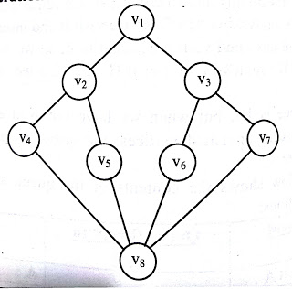
Perform BFS

Slide 85
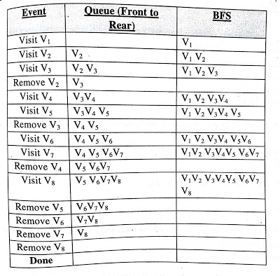
Perform BFS
The required BFS is V₁ V₂ V₃ V₄ V₅ V₆ V₇ V₈.

Slide 86
Find DFS in a di-graph
The rules for a DFS traversal of a graph same as for undirected graph
Difference-Adjacent nodes for a node A exists only if there exists an edge starting from A and incident to any other node

Slide 87
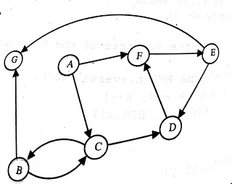
Find DFS & BFS in a di-graph
Let us consider the following di-graph-
Covering nodes in Alphabetical Order

Slide 88
Find DFS & BFS in a di-graph

Slide 89
Find DFS in a di-graph
The table below shows the stack contents at each push and pop operations:
The required DFS is A C B G D F E.
Event | Stack | DFS
Visit A | A | A
Visit C | AC | AC
Visit B | ACB | ACB
Visit G | ACBG | ACBG
Pop G | ACB
Pop B | AC
Visit D | ACD | ACBGD
Visit F | ACDF | ACBGDF
Visit E | ACDFE | ACBGDFE
Pop E | ACDF
Pop F | ACD
Pop D | AC
Pop C | A
Pop A | NULL

Slide 90
Find BFS in a di-graph
The rules for a BFS traversal of a graph are: -
Same as for Undirected Graph
Only concept of Directed Edges , Adjacency will differ

Slide 91
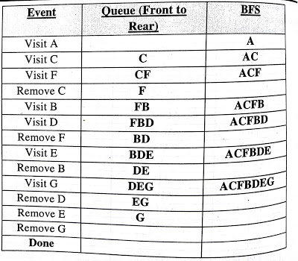
Find BFS in a di-graph
The table below shows the Queue contents at every insert and remove operations:
The required BFS is A C F B D E G.

Slide 92
Why Use Graphs?
Graphs serve as models of a wide range of objects:
A roadmap
A map of airline routes
A layout of an adventure game world
A schematic of the computers and connections that make up the Internet
The links between pages on the Web
The relationship between students and courses
A diagram of the flow capacities in a communications or transportation network

Slide 93

GRAPHS Representation :
Graph representation of a road network
A road network is a simple example of a graph,
Vertices represents cities and road connecting them are correspond to edges.
V= { Delhi, Chenai, Kolkata, Mumbai, Nagpur }
E= { (Delhi, Kolkata), (Delhi, Mumbai}, (Delhi, Nagpur), (Chenai, Kolkata), (Chenai, Mumbai), (Chenai, Nagpur), (Kolkata, Nagpur), (Mumbai, Nagpur) }

Slide 94
Applications of Graph Data Structure
Google maps
Facebook
World Wide Web
Operating System
??

Slide 95
Applications of Graph Data Structure
In Computer science graphs are used to represent the flow of computation.
Google maps –
uses graphs for building transportation systems,
where intersection of two(or more) roads are considered to be a vertex and
the road connecting two vertices is considered to be an edge,
thus their navigation system is based on the algorithm to calculate the shortest path between two vertices.

Slide 96
Applications of Graph Data Structure
In Facebook,
users are considered to be the vertices and
if they are friends then there is an edge running between them.
Facebook’s Friend suggestion algorithm uses graph theory.
Facebook is an example of undirected graph.

Slide 97
Applications of Graph Data Structure
In World Wide Web,
web pages = vertices.
There is an edge from a page u to other page v if there is a link of page v on page u.
This is an example of Directed graph.
It was the basic idea behind Google Page Ranking Algorithm.

Slide 98
Applications of Graph Data Structure
In Operating System,
we come across the Resource Allocation Graph where
each process and resources are considered to be vertices.

Slide 99

Applications of Graph Data Structure
Edges are drawn from
resources to the allocated process, or
from requesting process to the requested resource.
If this leads to any formation of a cycle then a deadlock may occur.

Slide 100

Resource Allocation Graph With A Deadlock
Suppose P3 requests for R2,
Since no resource instance is free, a request edge P3->R2 is added
So, Now Two cycles exist –
P1->R1->P2->R3->P3->R2->P1
P2->R3->P3->R2->P2
P1,P2,P3 are deadlocked

